Slide 1
Lab scale SSF
Mix Progen (2mL)
2 repetitions

Slide 2
TSS-VSS-sCOD

Slide 3
TSS-COD
Πείραμα 1 Πείραμα 2

Slide 4
HPLC (FW vs Experiment t=0), g/L
Experiment 1: FW/Water=1/3

Slide 5
HPLC (Experiment 1 and 2 (area)

Slide 6
HPLC (Experiment 1 and 2 (g/L)

Slide 7
HPLC (Experiment 1 and 2 (Reduction Increase rates)

Slide 8
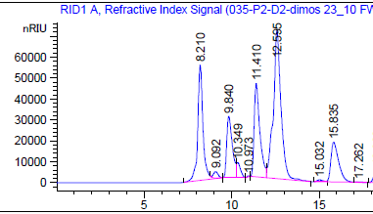
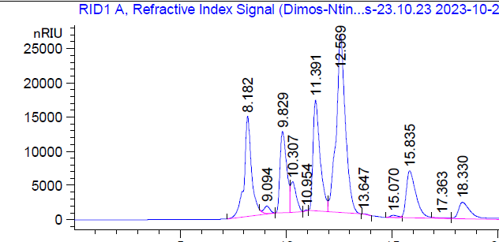
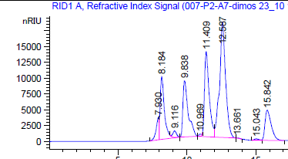
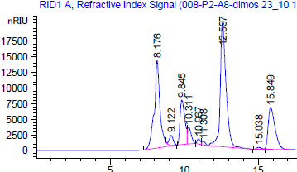
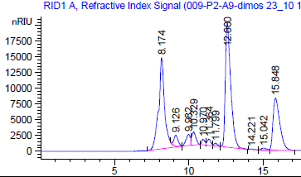
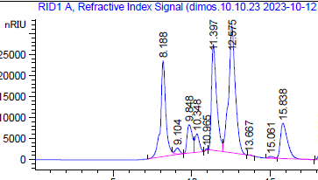
HPLC
FW
0 h
6 h
24 h
26 h
24 h blue mix

Slide 9
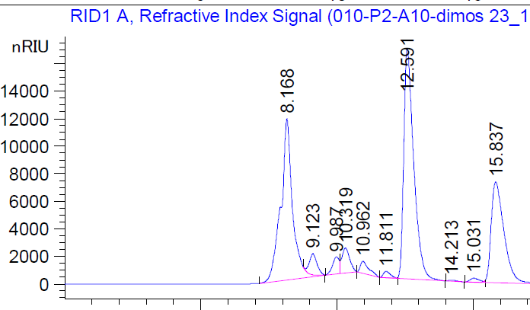
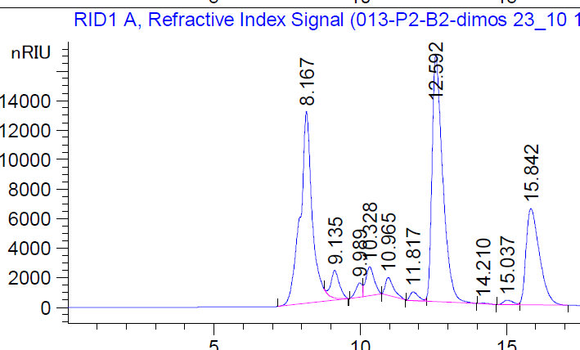
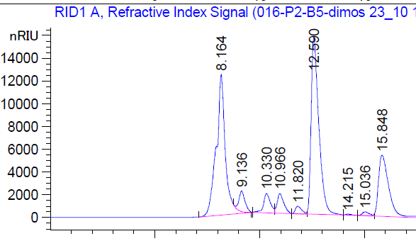
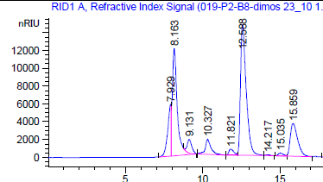
HPLC
26 h
28 h
50 h
74 h
98 h

Slide 10
HPLC
Compound | Retention Time
Unknown 1 | 9,094
Unknown 6 | 9,12
Sucrose | 9,829
Uknown 2 (sucrose) | 9,987
Unknown 3 | 10,307
Unknown 4 | 10,967
Glucose | 11,391
Unknown 5 (fructose) | 11,799
Fructose | 12,569
Lactic | 15,664
Acetic | 18,163
Propionic | 21,756
Ethanol | 24,785

Slide 11
HPLC
Compound | Retention Time
Unknown 1 | 9,094
Unknown 6 | 9,12
Sucrose | 9,829
Uknown 2 (sucrose) | 9,987
Unknown 3 | 10,307
Unknown 4 | 10,967
Glucose | 11,391
Unknown 5 (fructose) | 11,799
Fructose | 12,569
Lactic | 15,664
Acetic | 18,163
Propionic | 21,756
Ethanol | 24,785

Slide 12
HPLC
Compound | Retention Time
Unknown 1 | 9,094
Unknown 6 | 9,12
Sucrose | 9,829
Uknown 2 (sucrose) | 9,987
Unknown 3 | 10,307
Unknown 4 | 10,967
Glucose | 11,391
Unknown 5 (fructose) | 11,799
Fructose | 12,569
Lactic | 15,664
Acetic | 18,163
Propionic | 21,756
Ethanol | 24,785

Slide 13
HPLC
Compound | Retention Time
Unknown 1 | 9,094
Unknown 6 | 9,12
Sucrose | 9,829
Uknown 2 (sucrose) | 9,987
Unknown 3 | 10,307
Unknown 4 | 10,967
Glucose | 11,391
Unknown 5 (fructose) | 11,799
Fructose | 12,569
Lactic | 15,664
Acetic | 18,163
Propionic | 21,756
Ethanol | 24,785

Slide 14
HPLC corrected
Compound | Retention Time
Unknown 1 | 9,094
Unknown 6 | 9,12
Sucrose | 9,829
Uknown 2 (sucrose) | 9,987
Unknown 3 | 10,307
Unknown 4 | 10,967
Glucose | 11,391
Unknown 5 (fructose) | 11,799
Fructose | 12,569
Lactic | 15,664
Acetic | 18,163
Propionic | 21,756
Ethanol | 24,785
Compound | Retention Time
Unknown 1 | 9,094
Unknown 1 | 9,12
Sucrose | 9,829
Sucrose | 9,987
Unknown 3 | 10,307
Unknown 4 | 10,967
Glucose | 11,391
Glucose | 11,799
Fructose | 12,569
Lactic | 15,664
Acetic | 18,163
Propionic | 21,756
Ethanol | 24,785
Βαθμονόμηση glucose, sucrose, fructose
Ταυτοποίηση Unknown 3
Unknown 4 πάντα χαμηλό

